Slide 1
DESIGN OF LOW-POWER N*N MAGNITUDE CAMPARATOR
Presented By :
Fatima Zahran
Baraa Nasar
Maha Eyad
Birzeit University | 17 Aug 2024

Slide 2
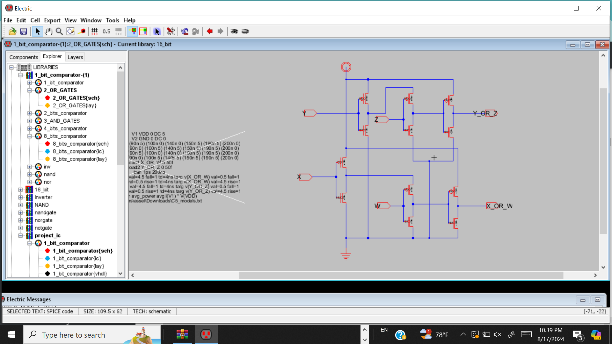
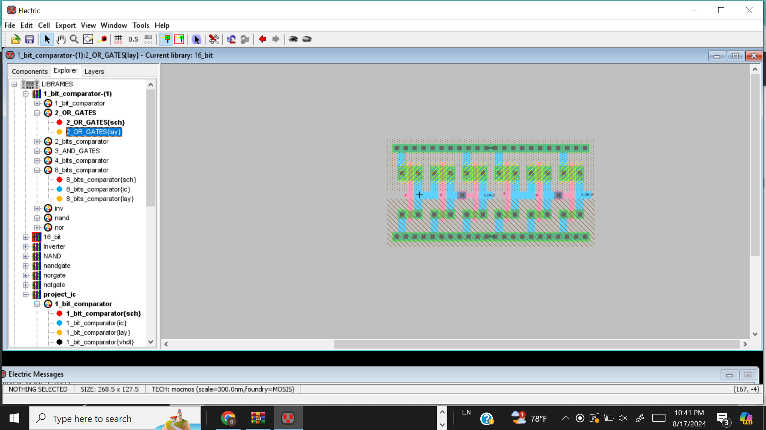
1
2-Input OR Gate
2-Input OR Schematic
2-Input OR Layout

Slide 3
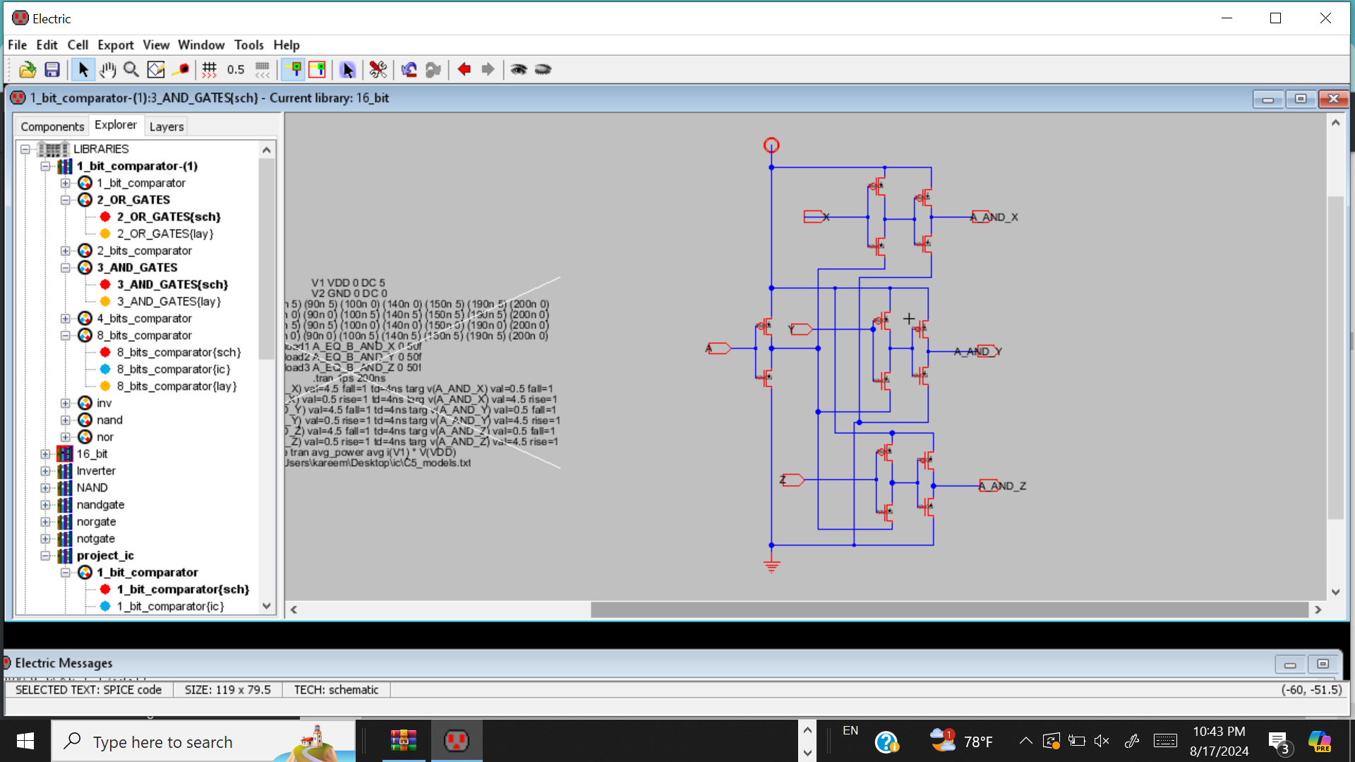
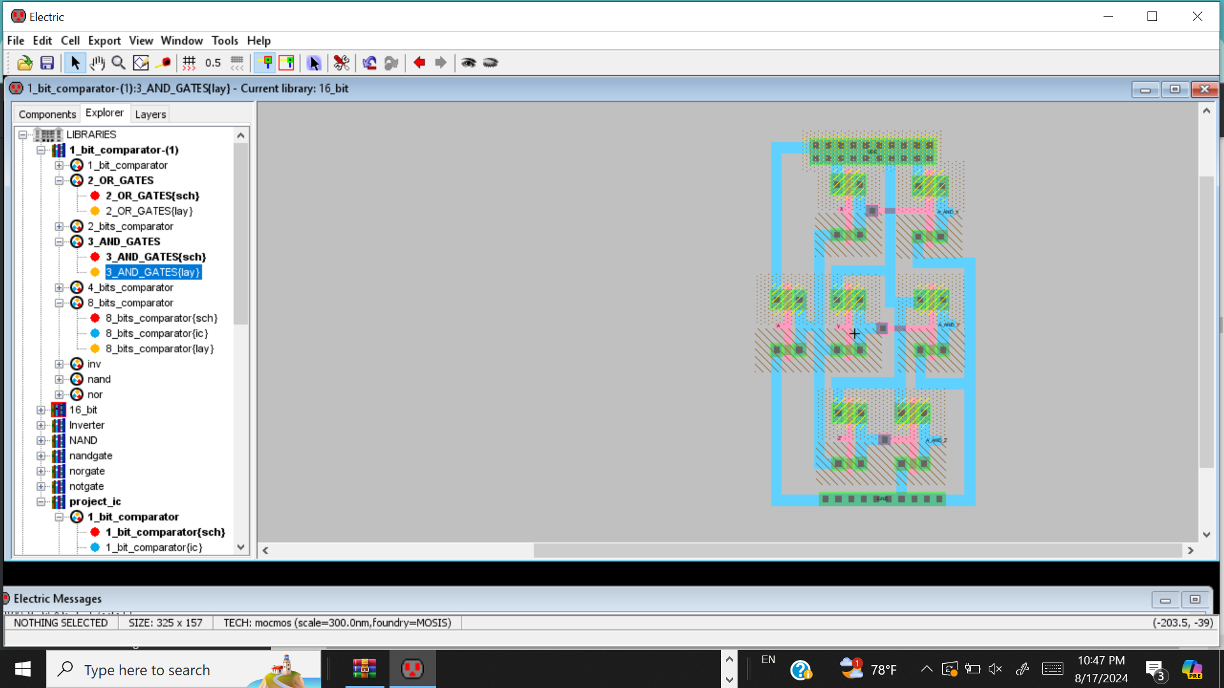
2
3-input AND Gate
3-input AND Schematic
3-input AND Layout

Slide 4
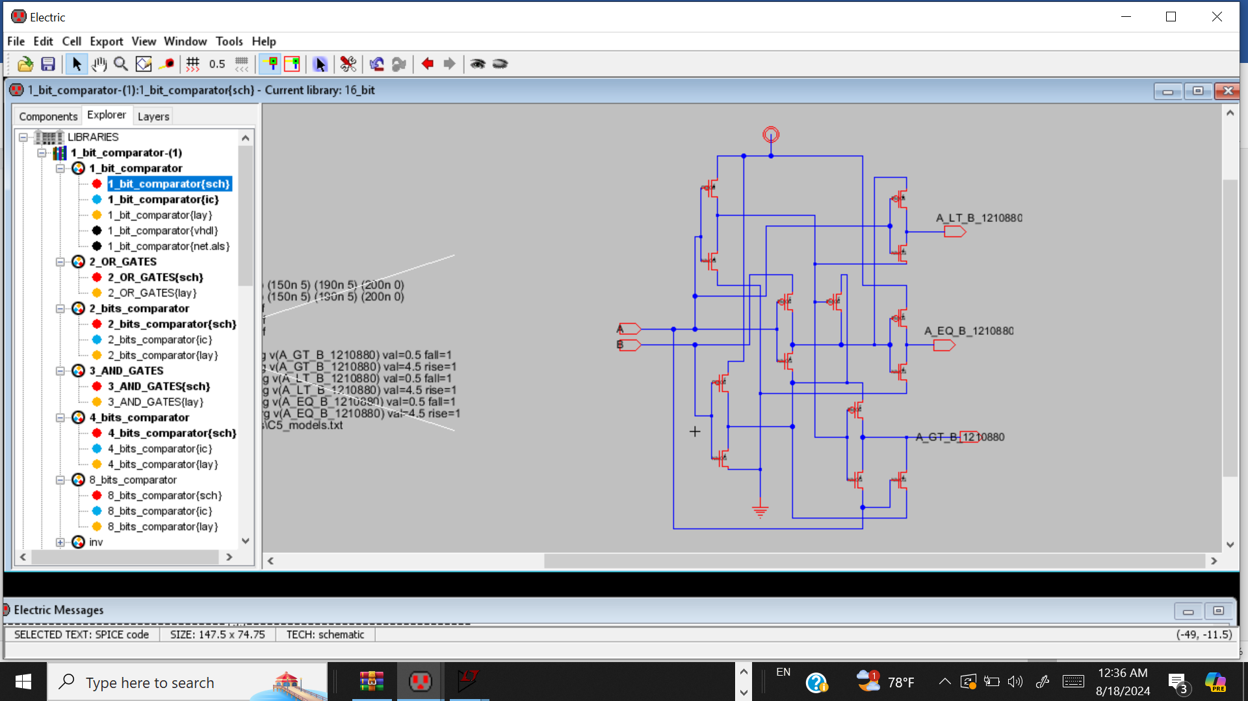
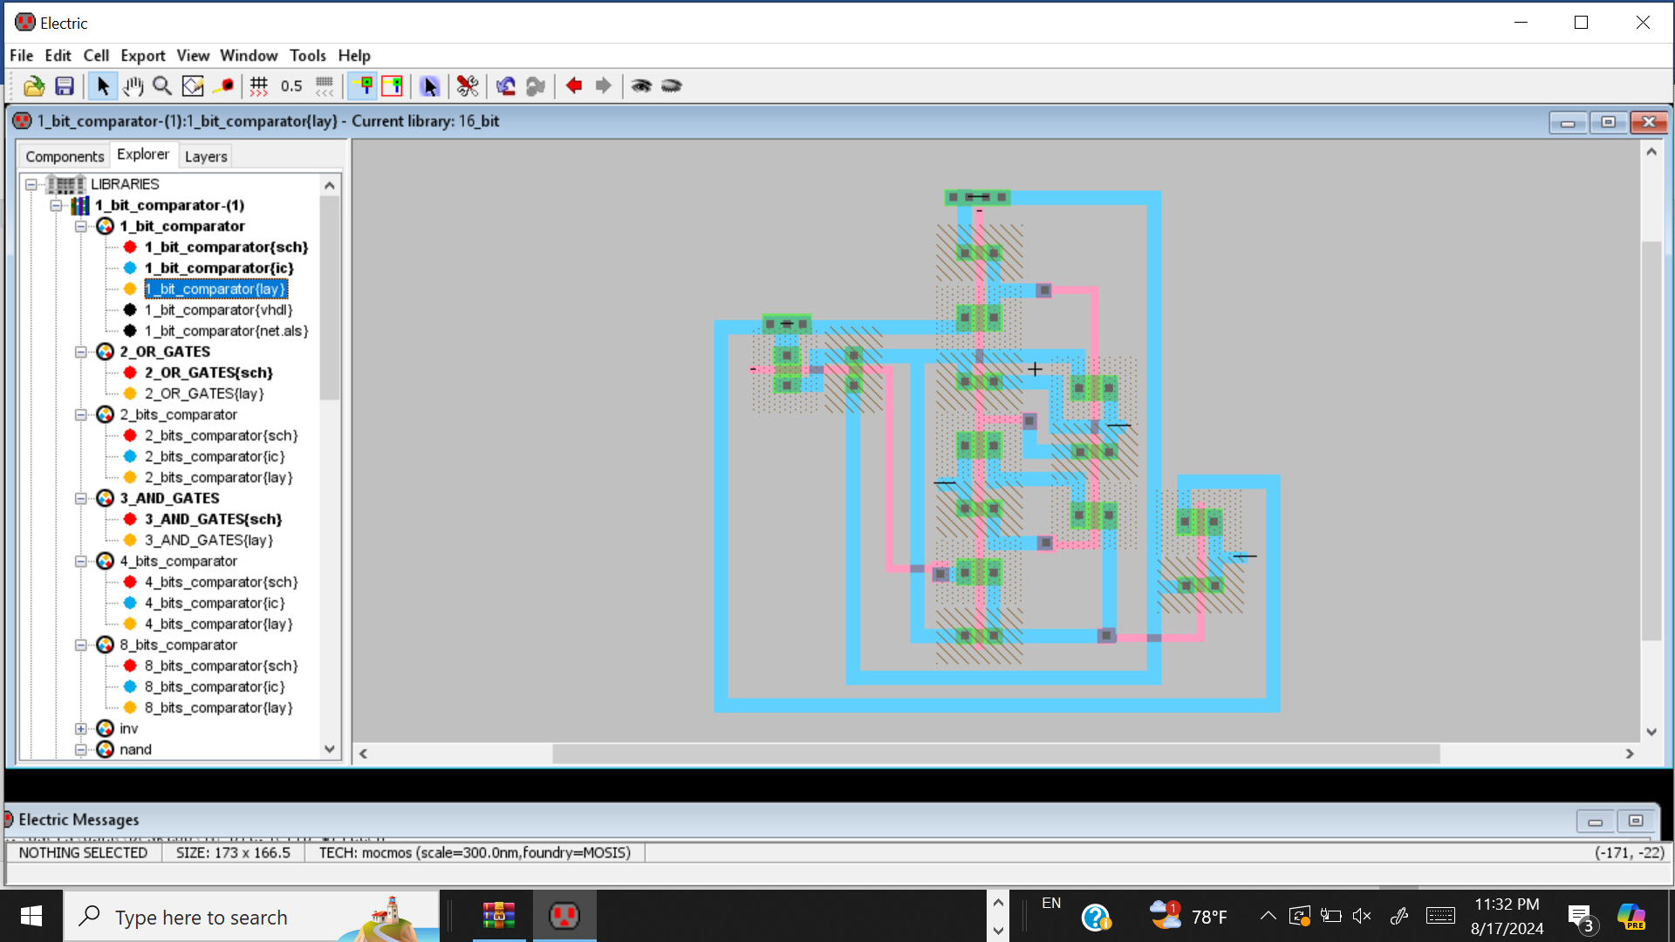
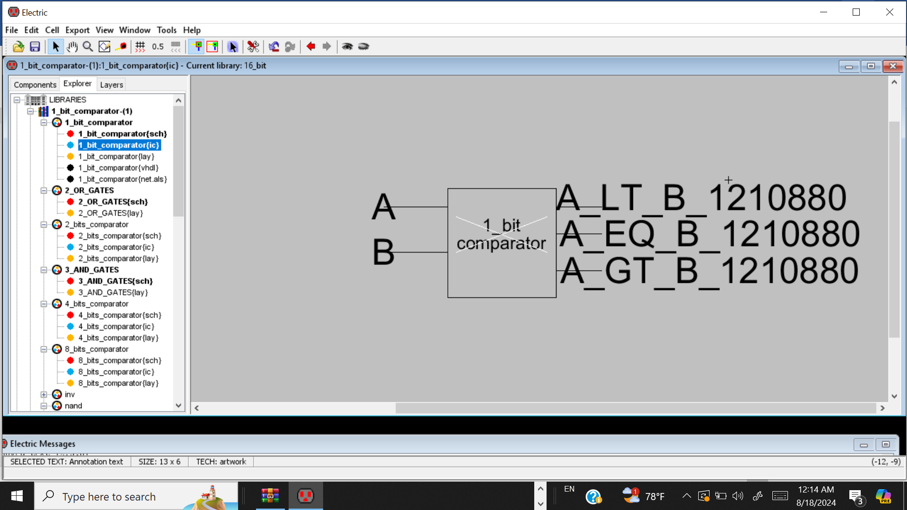
3
1_bit_comparator
1_bit_comparator Layout
1_bit_comparator Schematic
Block Diagram 1_bit_Comparator

Slide 5
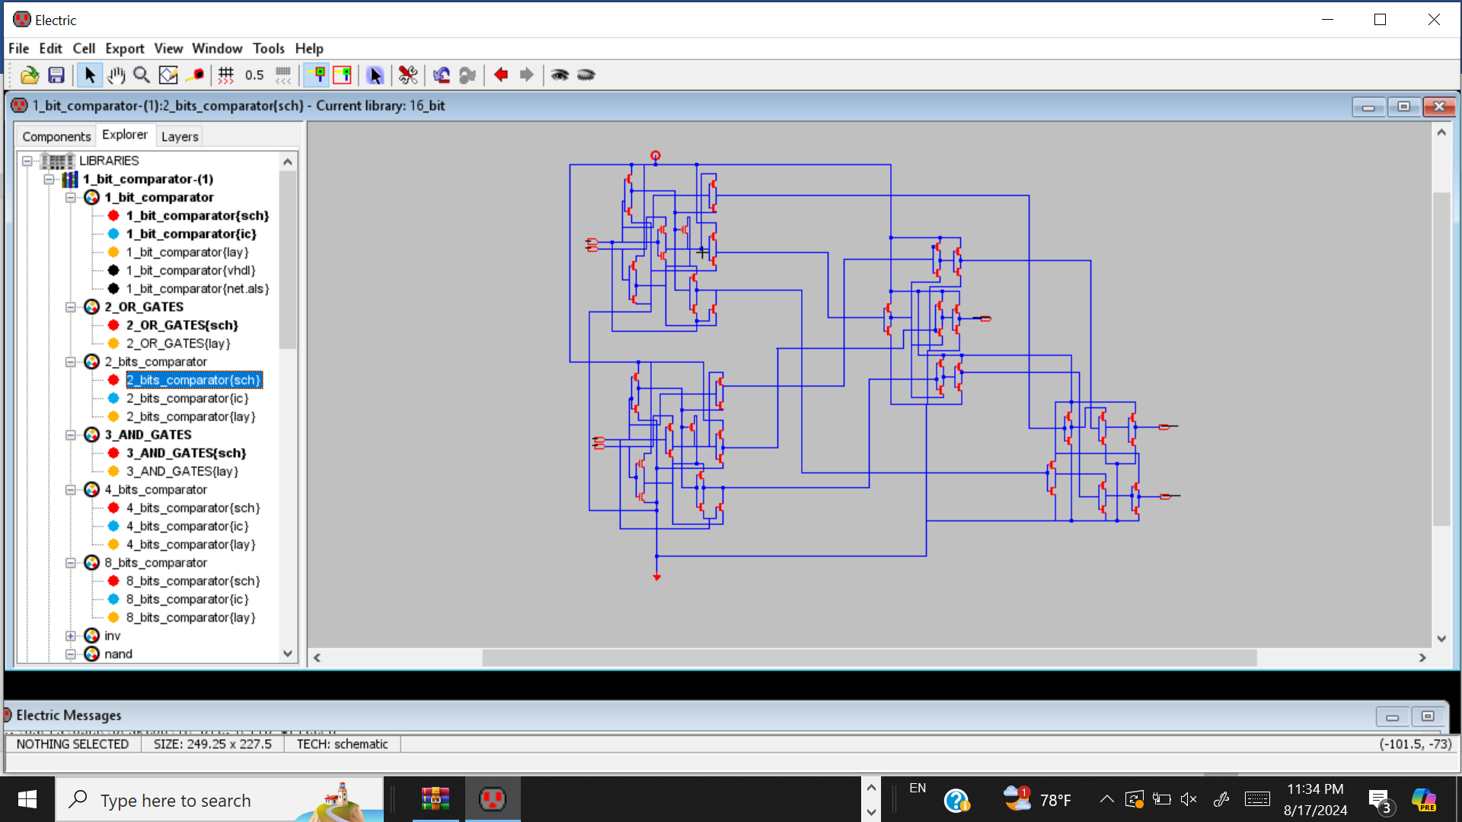
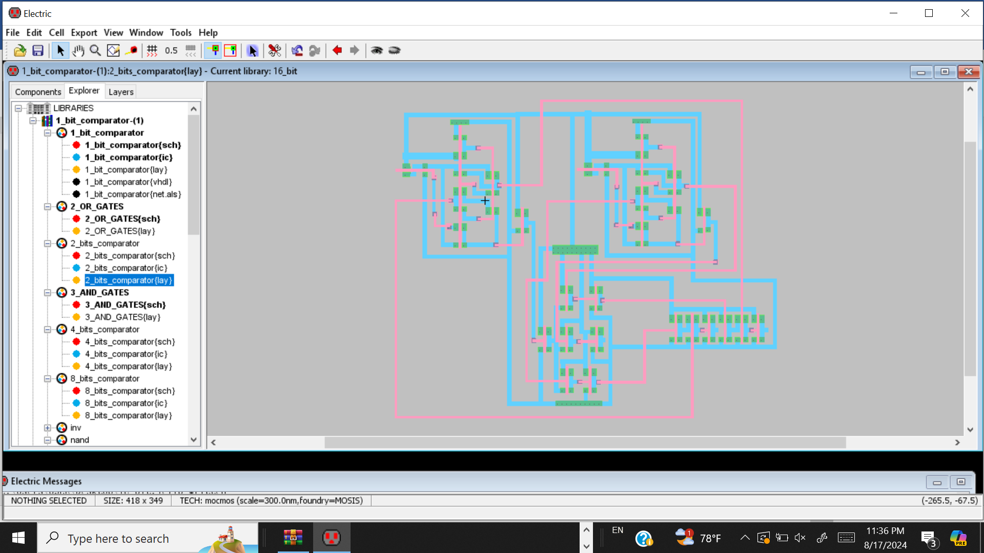
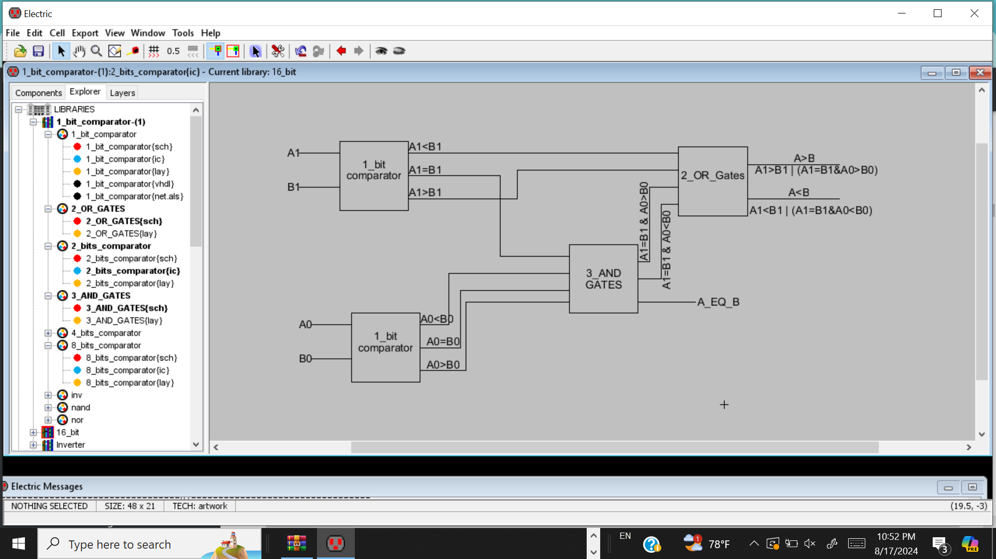
4
2-Bit Comparator
2-Bit Comparator Block Diagram
2-Bit Comparator Schematic
2-Bit Comparator Block Diagram

Slide 6
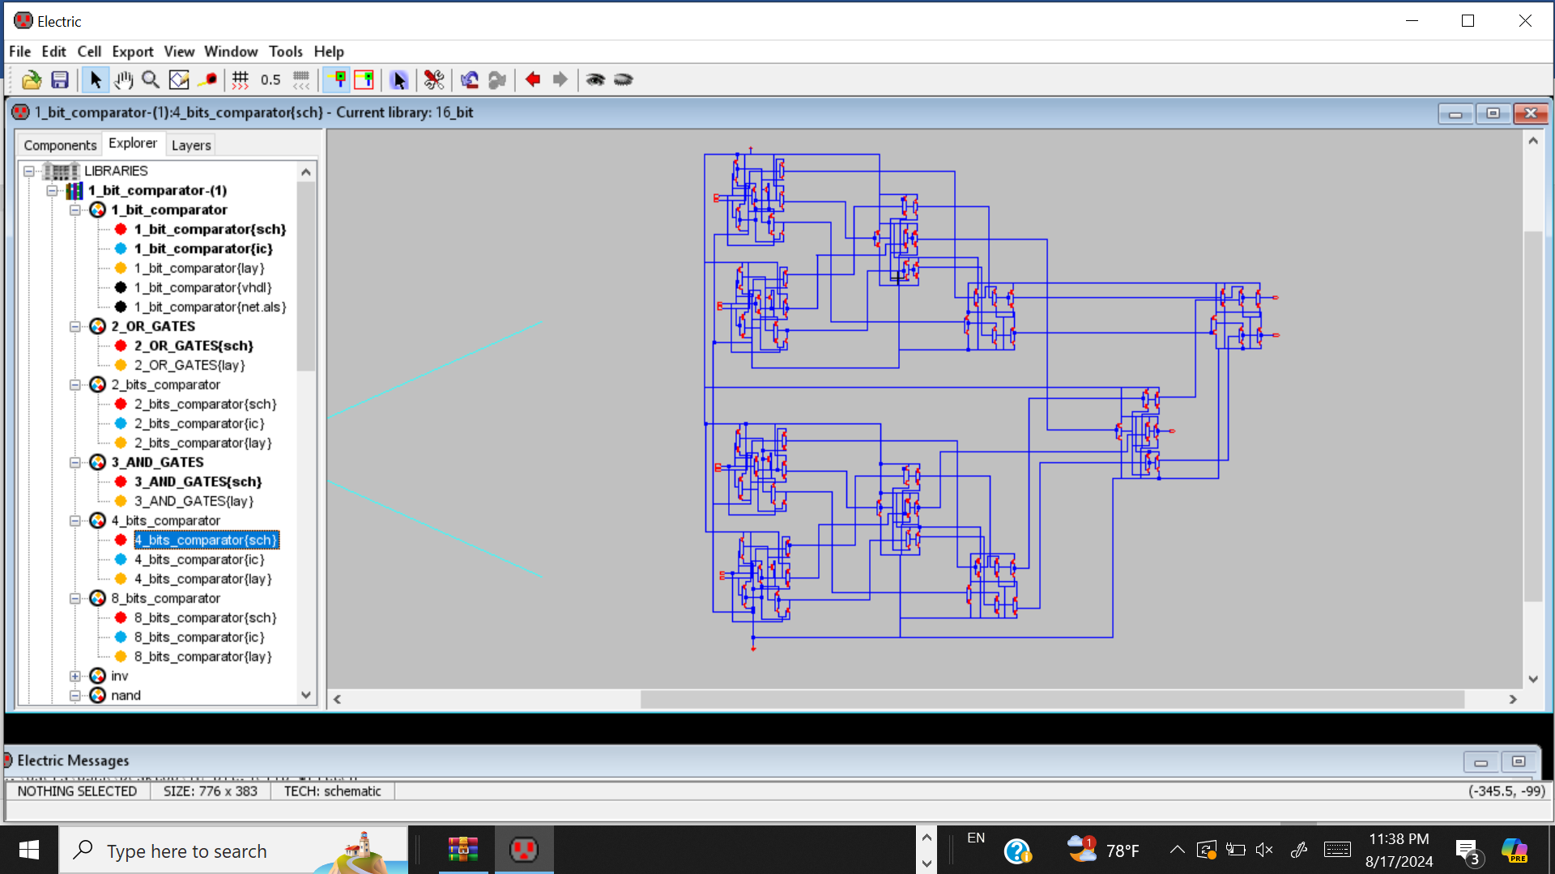
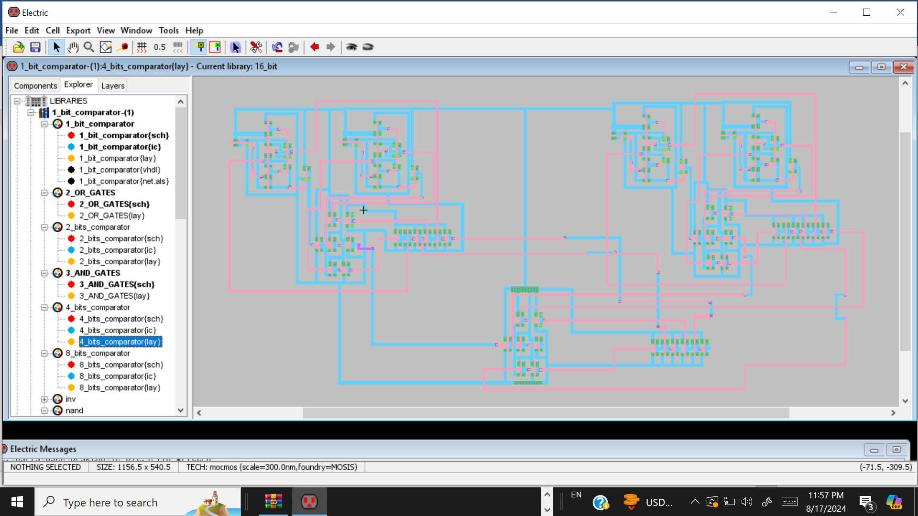
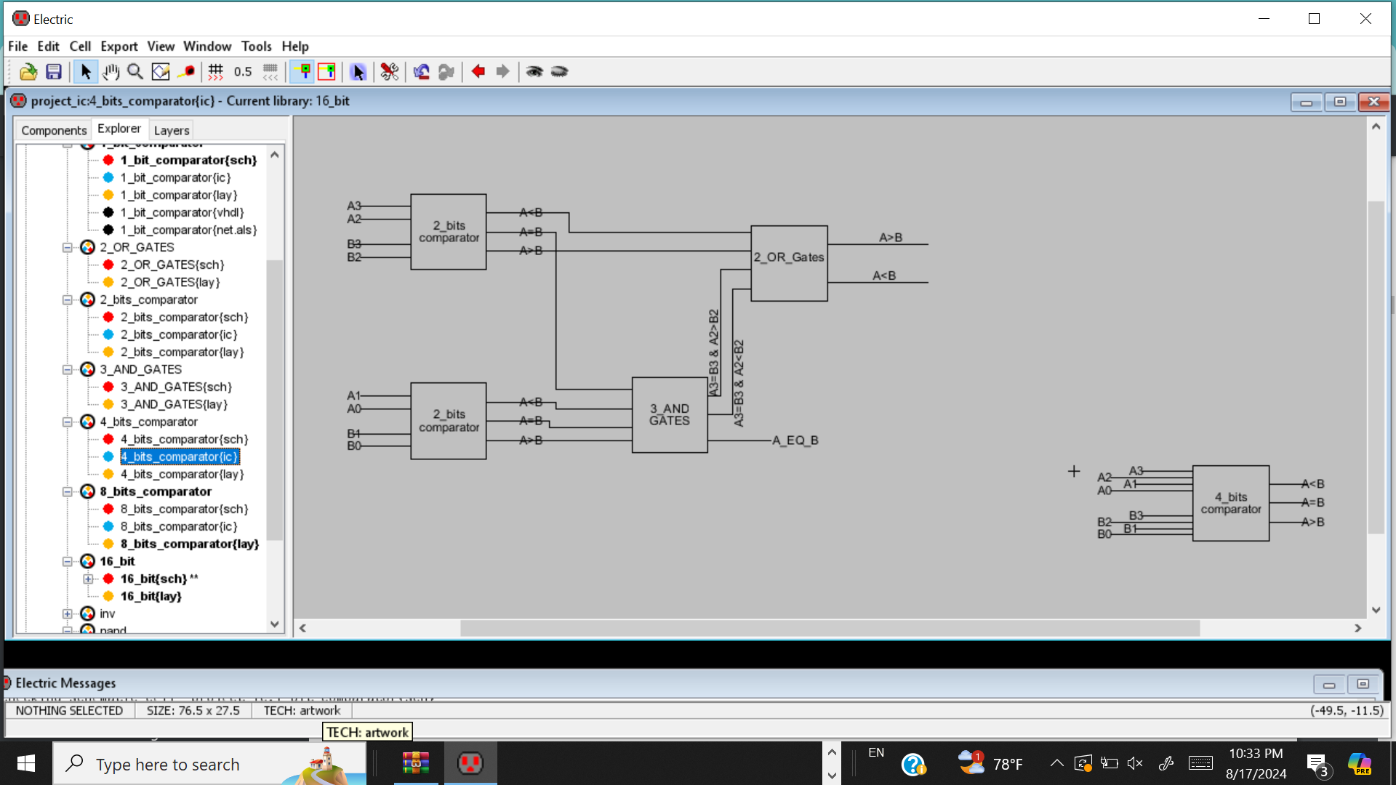
5
4_bit_comparator
4-Bit Comparator Layout
4-Bit Comparator Schematic
4-Bit Comparator Block Diagram

Slide 7
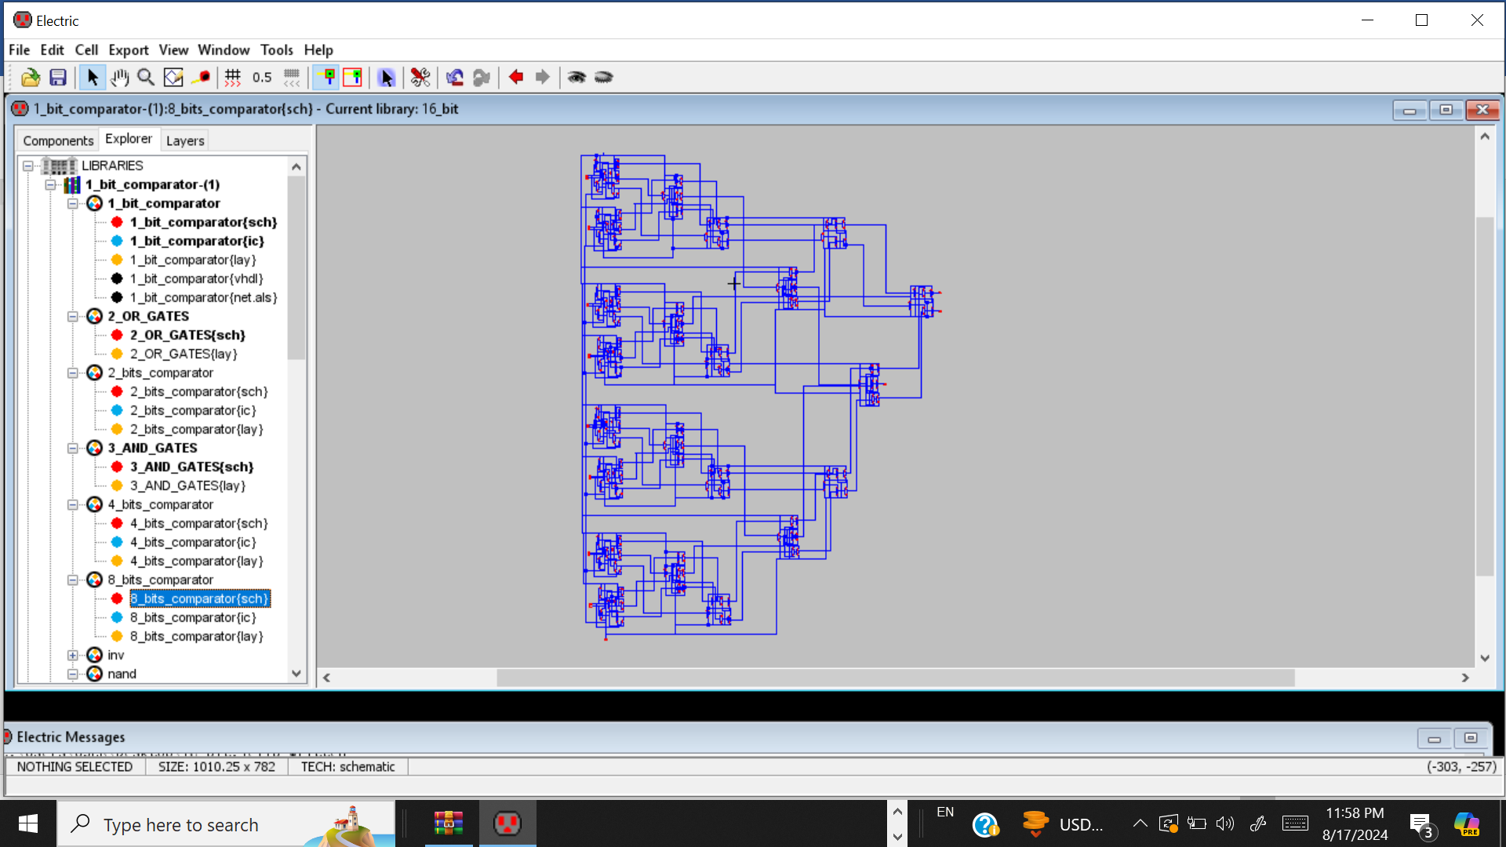
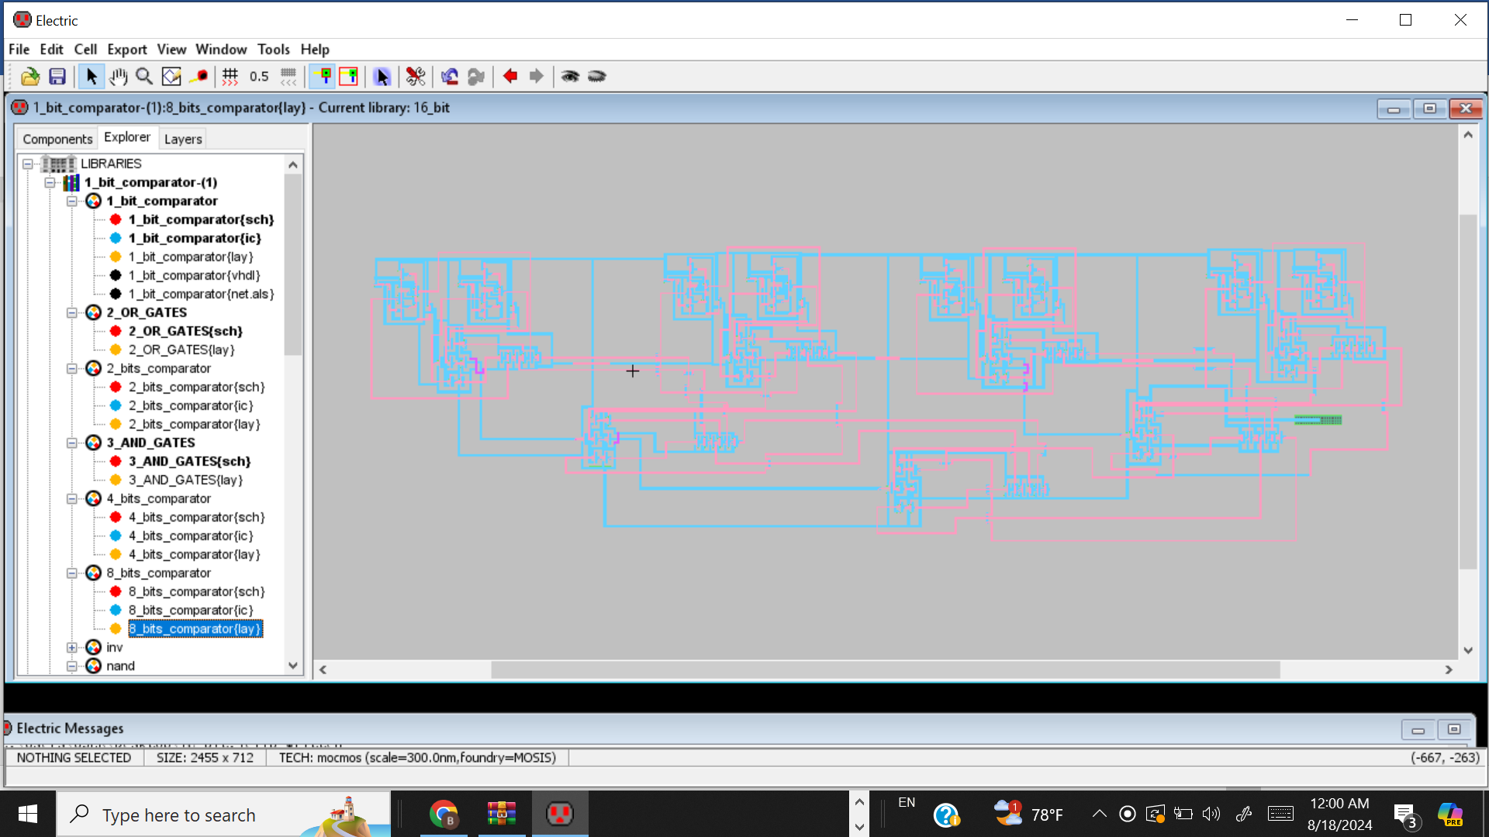
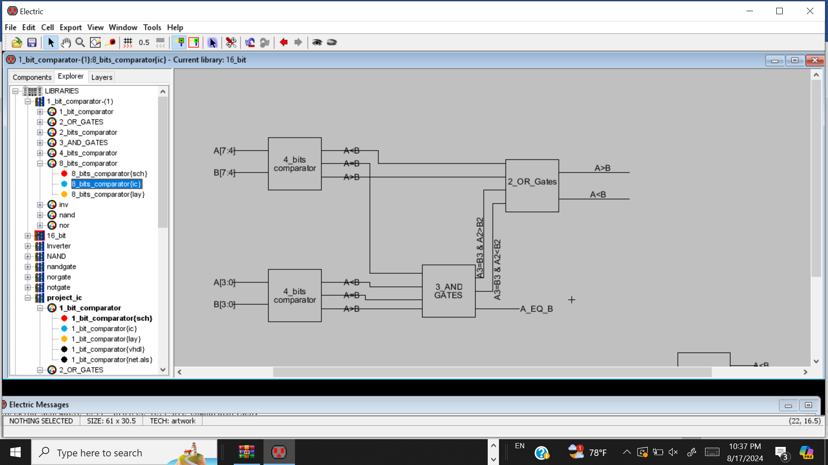
6
8-Bit Comparator
8-Bit Comparator Layout
8-Bit Comparator Schematic
8-Bit Comparator Block Diagram

Slide 8
7
Simulations

Slide 9
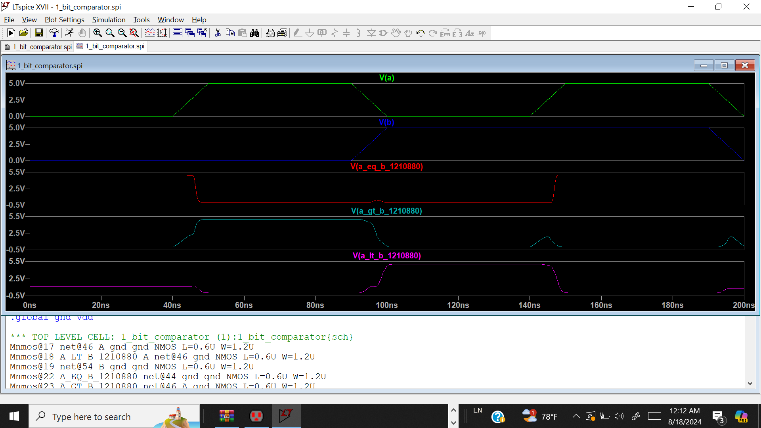
8
1-Bit Comparator simulation

Slide 10
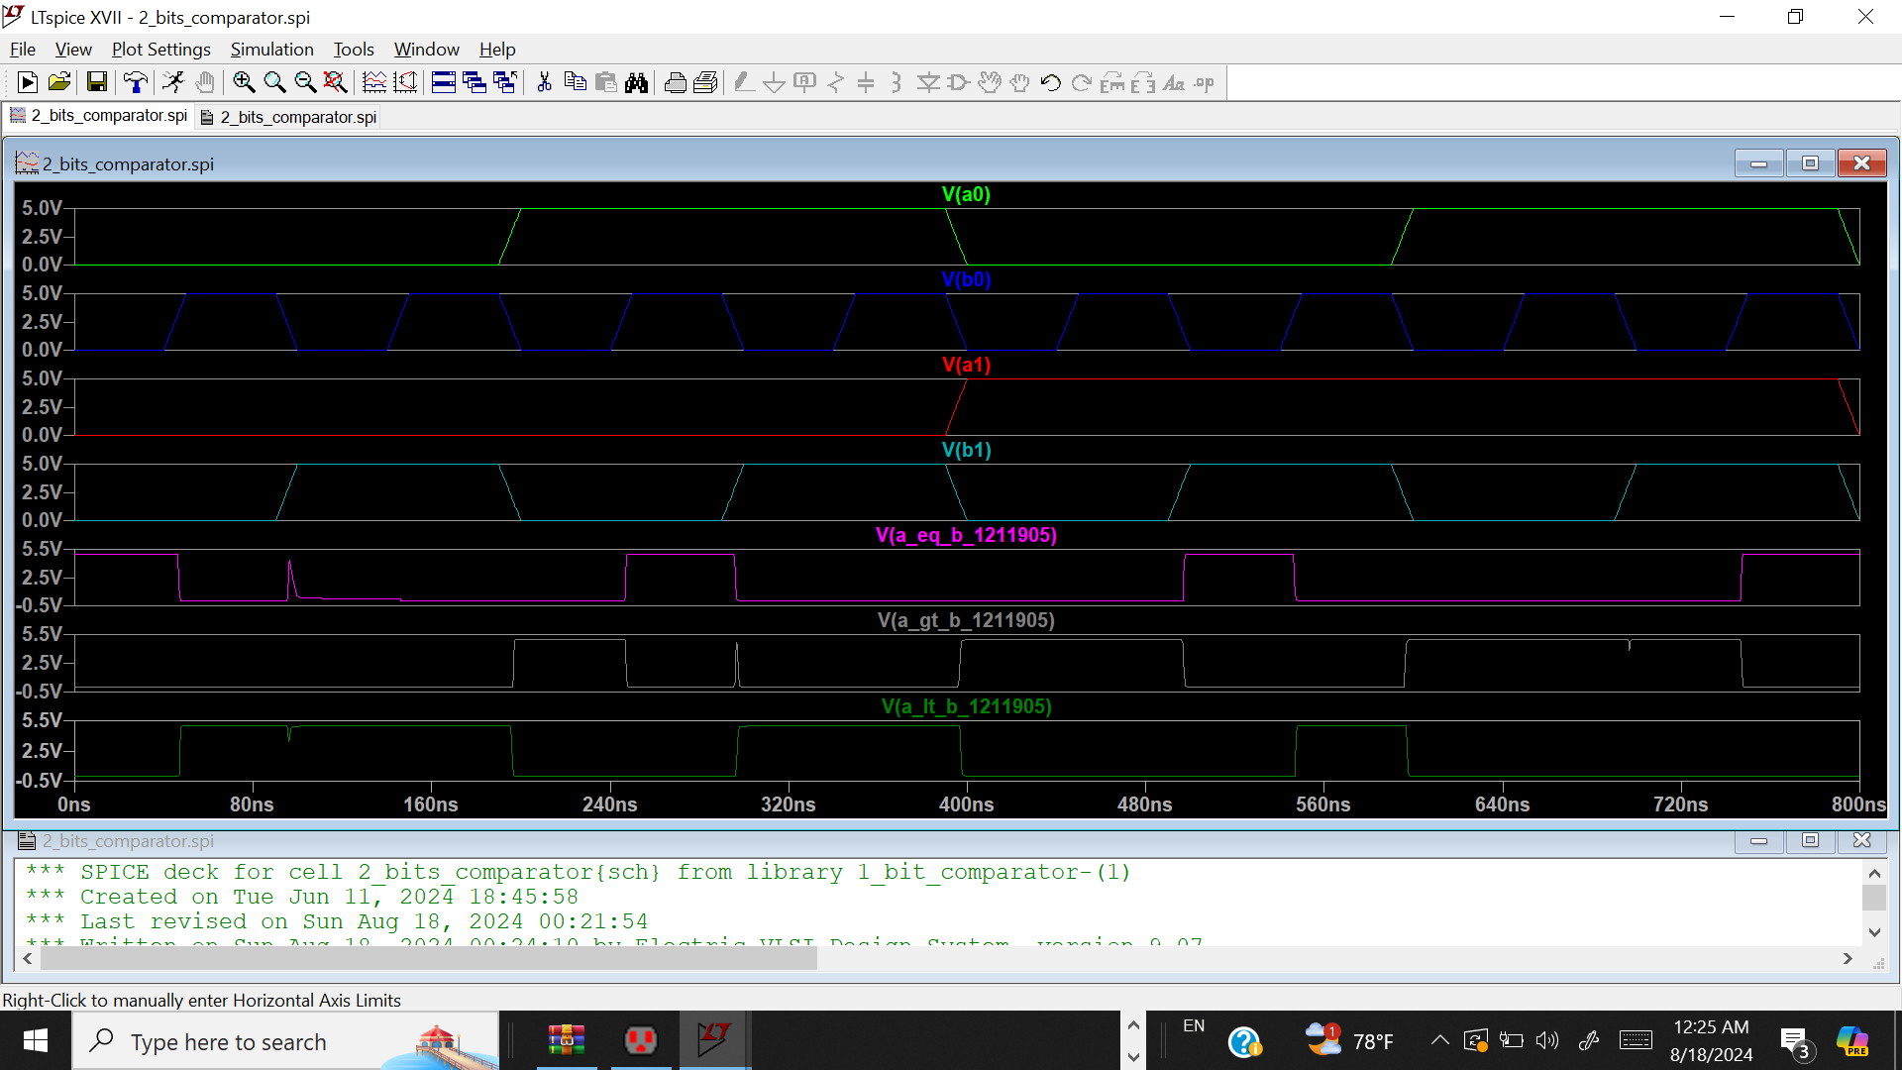
9
2-Bit Comparator simulation

Slide 11
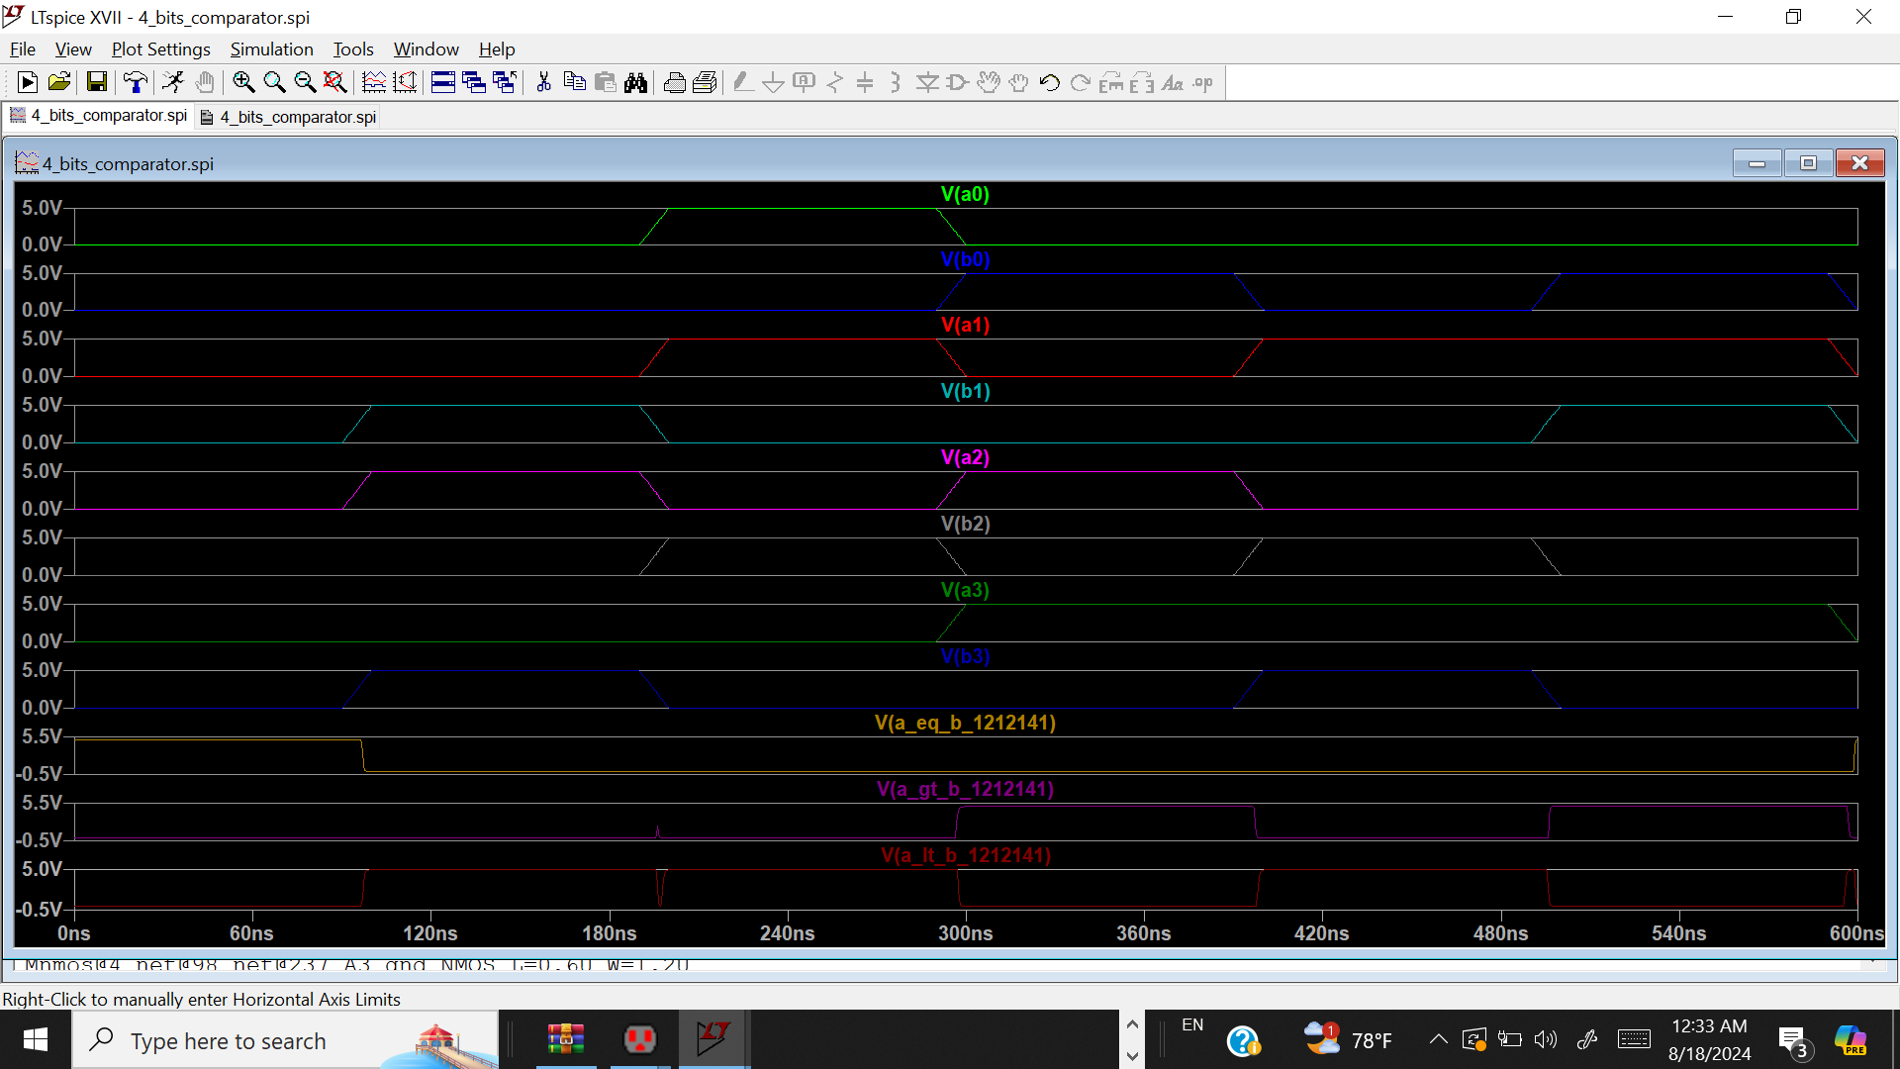
10
4-Bit Comparator simulation

Slide 12
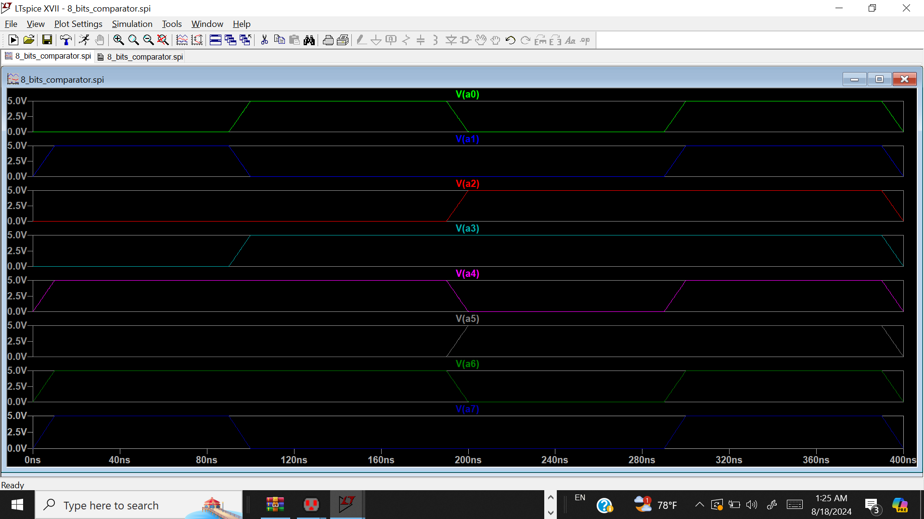
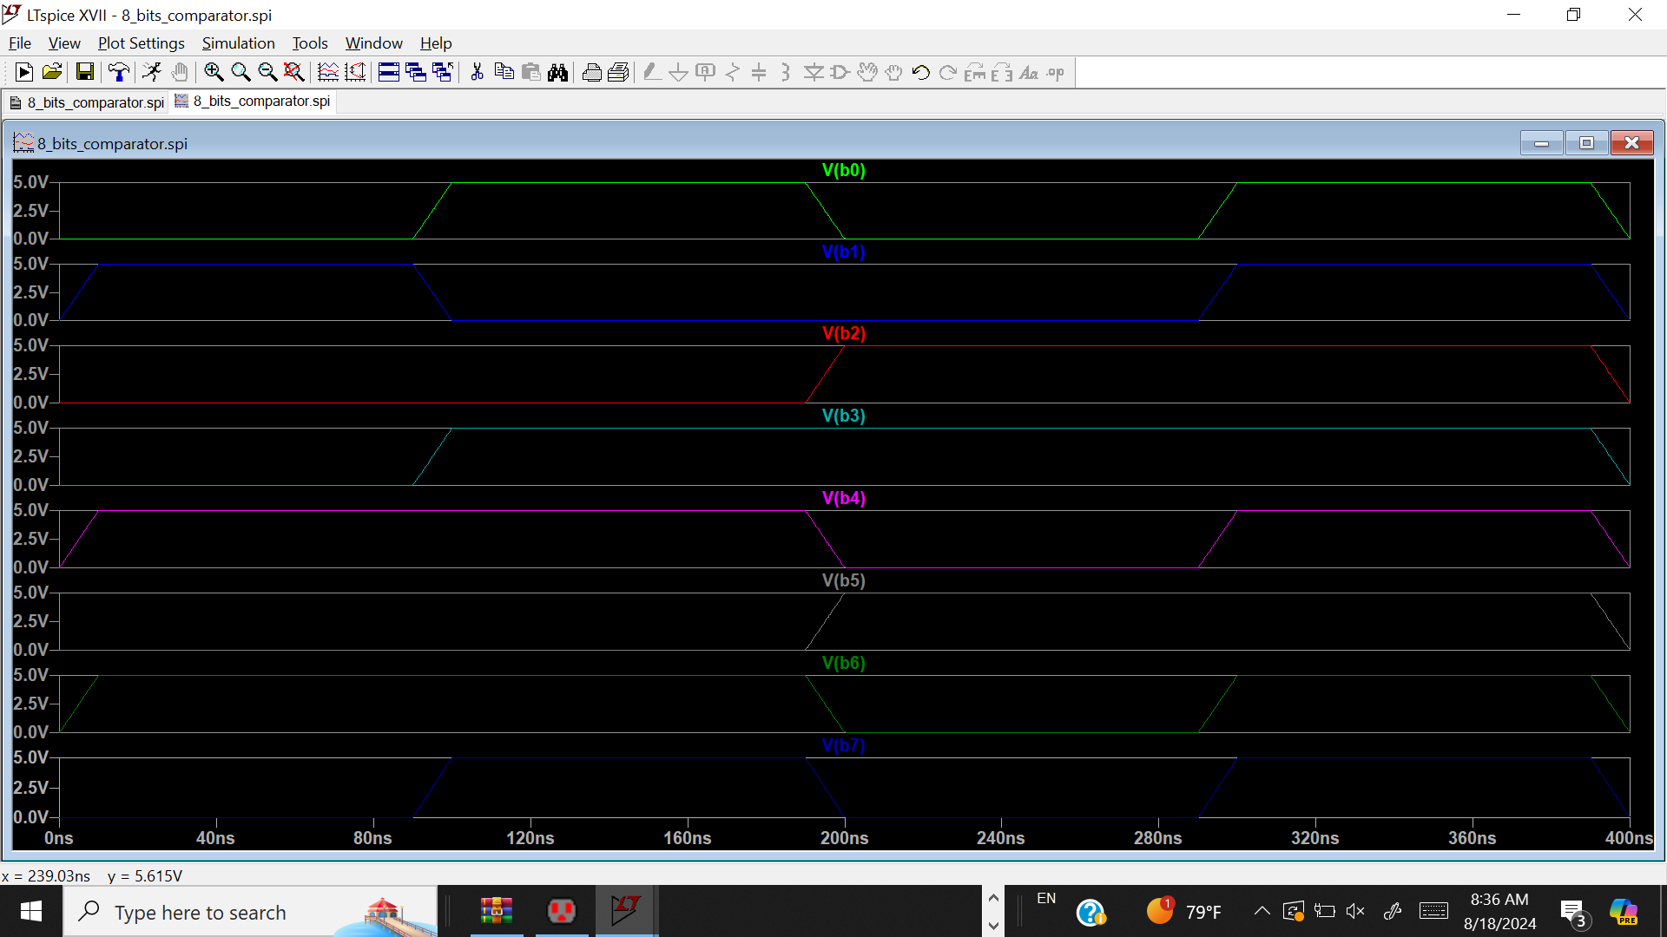
11
8-Bit Comparator simulation Inputs
8-Bit Comparator simulation Input A
8-Bit Comparator simulation Input B

Slide 13
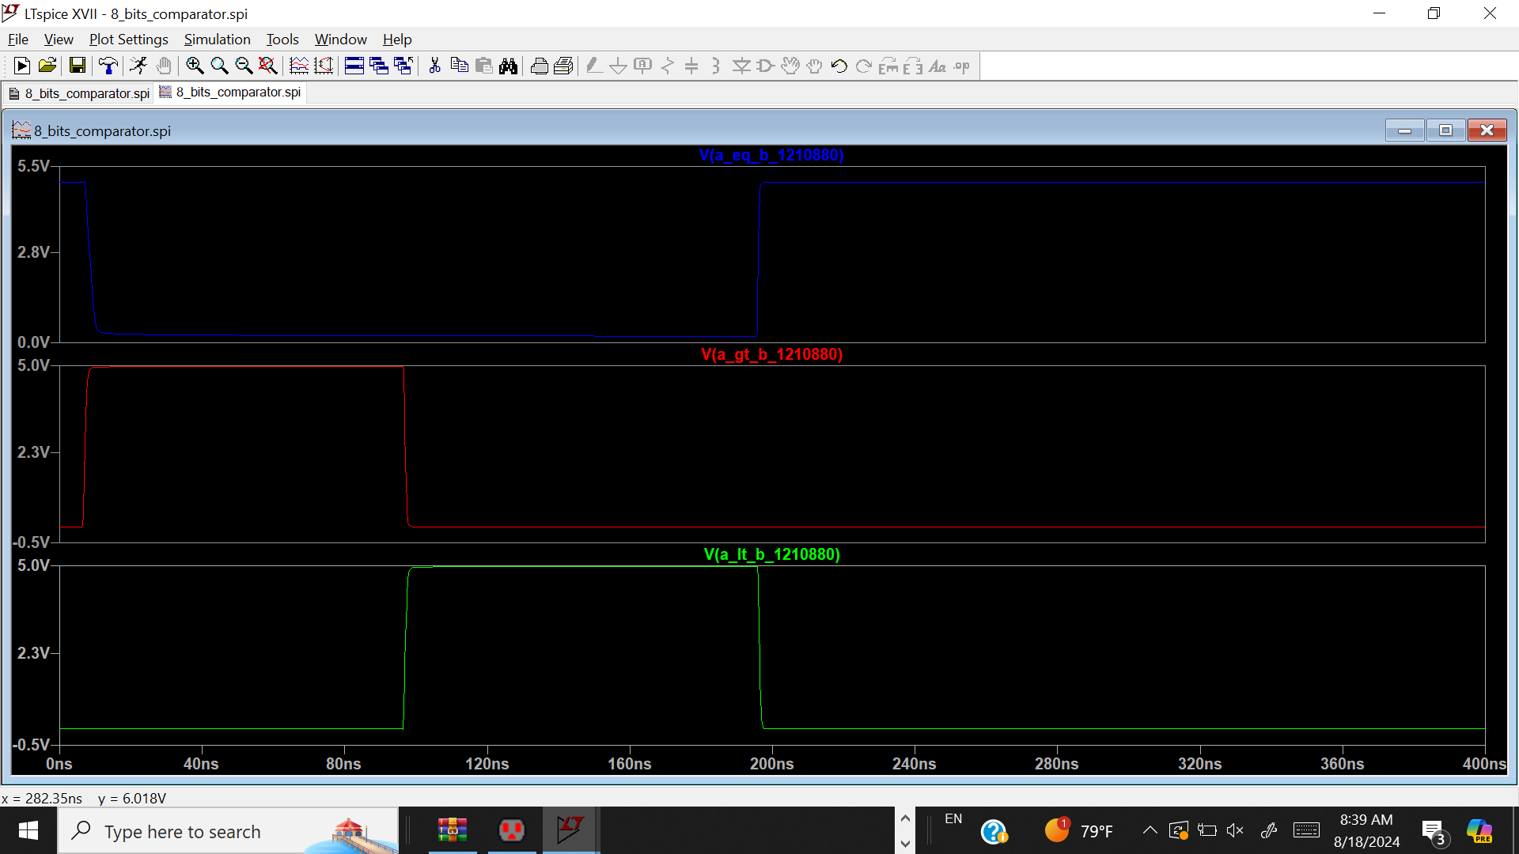
12
8-Bit Comparator simulation

Slide 14
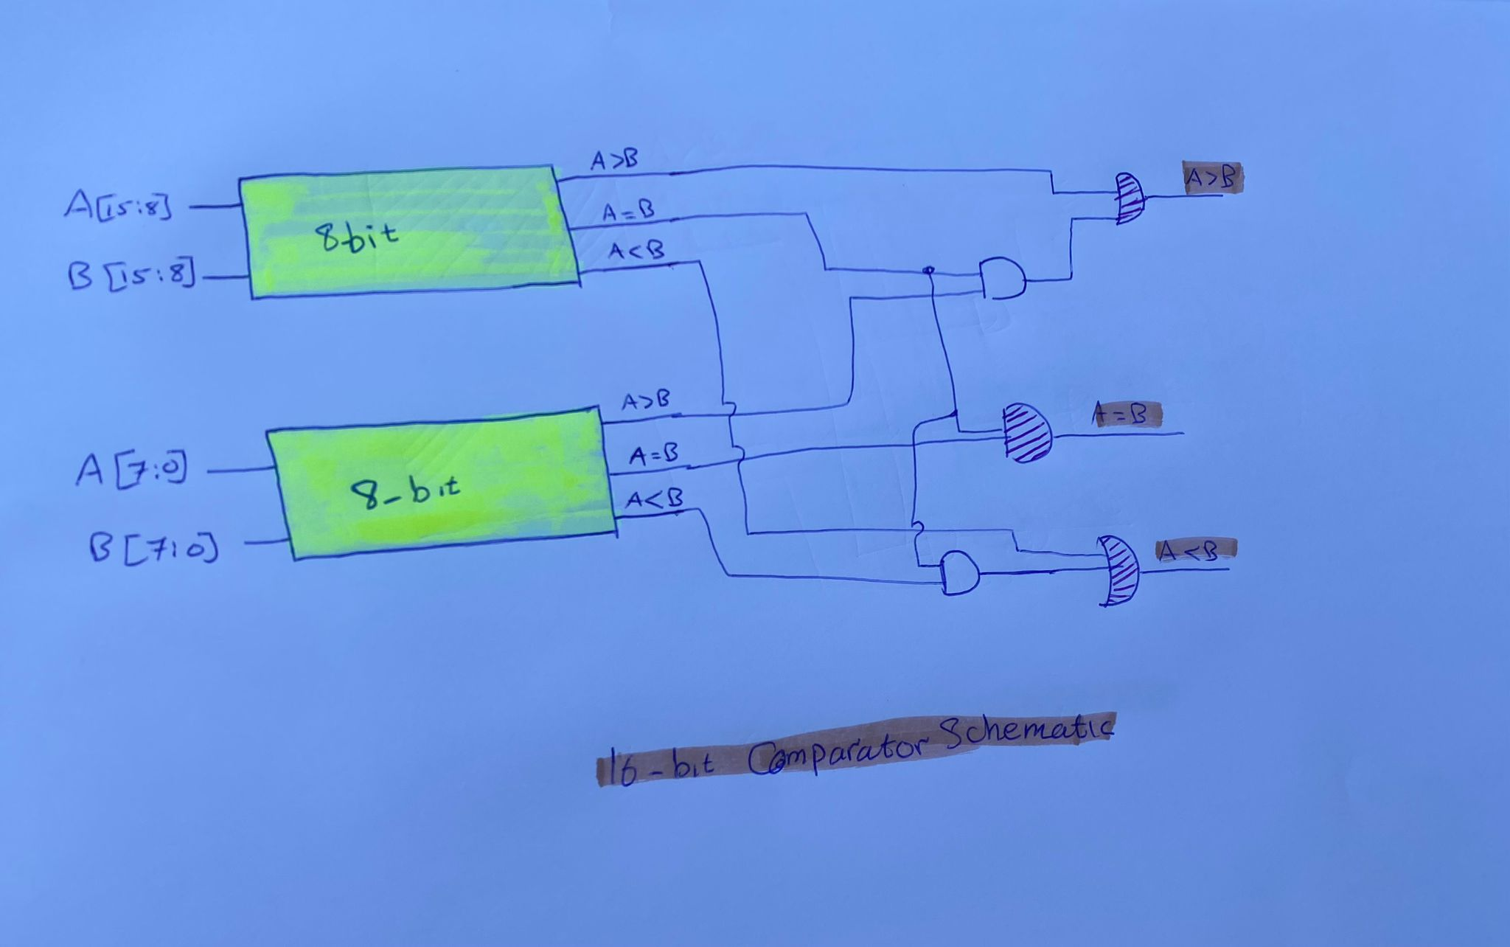
16_bit_Comparator

Slide 15
THANK YOU

